Slide 1

BURPSUITE
Network & System Security CSD4003
Department of Cyber Security & Digital Forensics, VIT Bhopal
A Web Hacking & Penetration Testing tool

Slide 2
Table of contents
What is Burpsuite?
Burp Modules
Target
Proxy
Intruder
Repeater
Decoder
Applications

Slide 3
1.
What is
Burp Suite ?
Burp Suite is an integrated platform for performing security testing of Web Applications.
The Tool is coded in Java and is developed by PortSwigger security.
The Tool comes with two different editions:
Community Version (Free)
Professional Version (Paid)
Let’s start with the Introduction of tool first.

Slide 4
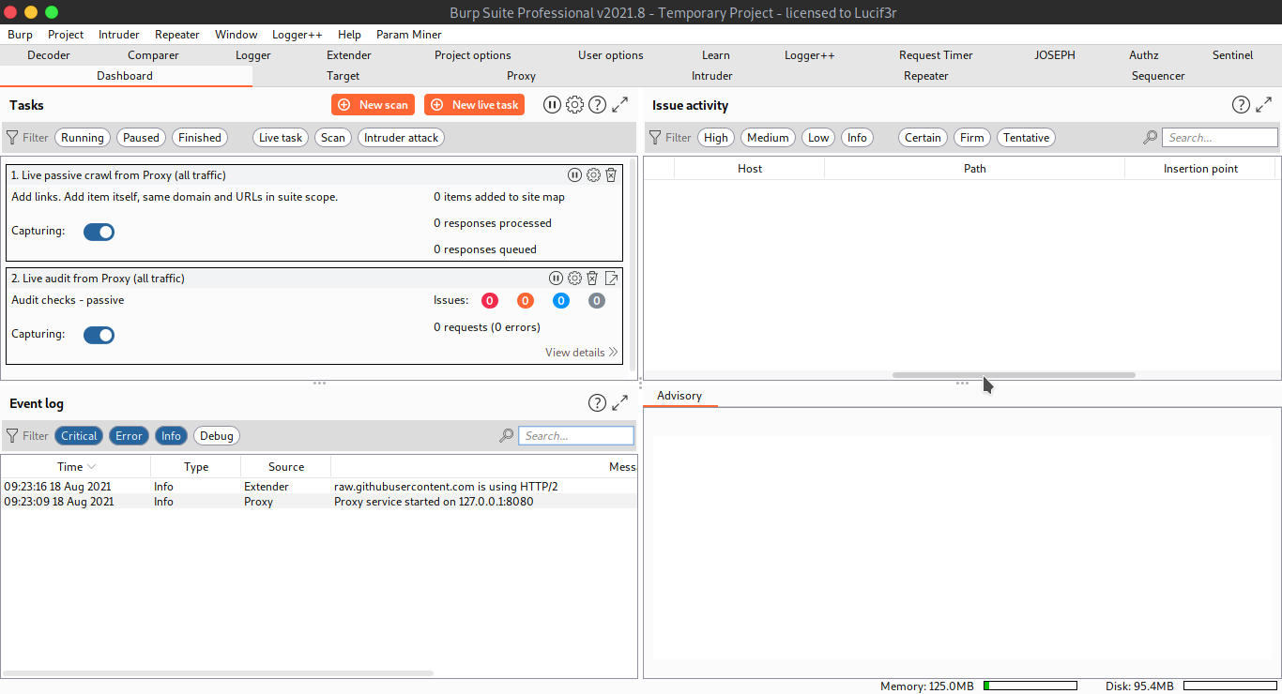
1.
What is
Burp Suite ?
Burp Suite is an integrated platform for performing security testing of Web Applications.
The Tool is coded in Java and is developed by PortSwigger security.
The Tool comes with two different editions:
Community Version (Free)
Professional Version (Paid)
Let’s start with the Introduction of tool first.

Slide 5
How to install BurpSuite Community edition?
First,you head to PortSwigger’s official downloads page - https://portswigger.net/burp/releases/professional-community-2021-10-2?requestededition=community
Select the OS onto which you need to download it
For Windows:-
Select Windows x64 version Download the .exe file
Install and click ‘Yes' when prompted
For Linux:-
Select the Linux version
The .sh file will be downloaded to /home/Kali/Downloads
Execute the file using the command -./Burpsuite_community-linux-v2021.sh

Slide 6
2.
BurpModules:
2.1Target
The Target tool gives you an overview of your target application contents, & functionality, and lets you drive the key parts of your testing workflow.
The key steps that are typically involved in using the target tab are described below:
Site Map
Scope
Issue Definitions

Slide 7
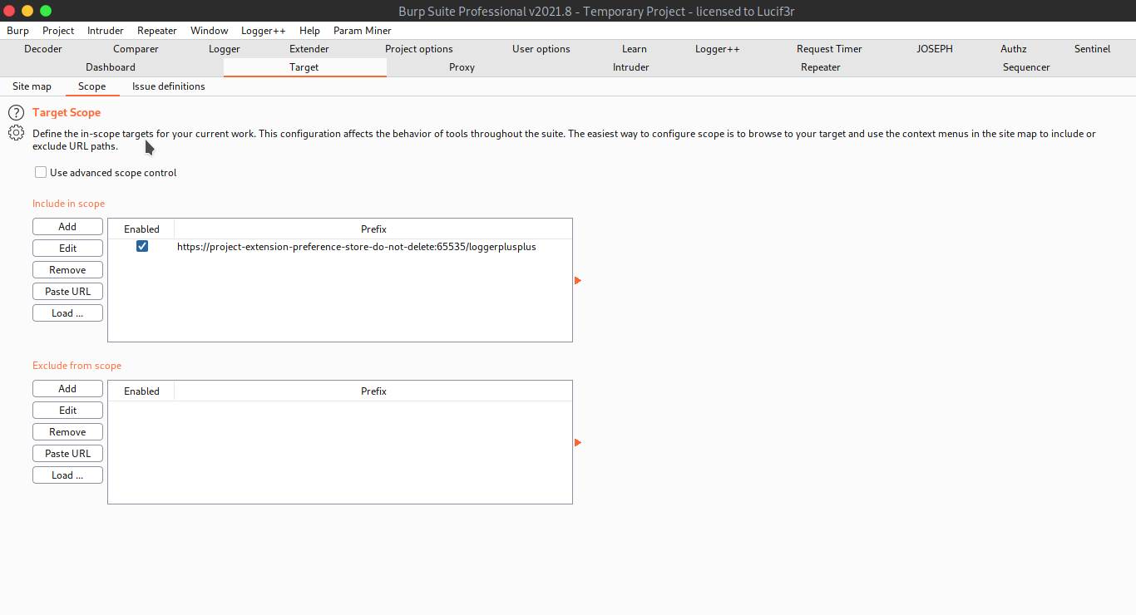
2.
BurpModules:
2.1Target
The Target tool gives you an overview of your target application’s contents, & functionality, and lets you drive the key parts of your testing workflow.
The key steps that are typically involved in using the target tab are described below:
Site Map
Scope
Issue Definitions

Slide 8
2.
BurpModules:
2.2 Proxy
The Proxy Module is considered to be the most useful part in the BurpSuite.
The proxy module is used to configure the system so as to intercept the traffic between a Browser and the Server.
It operates by being the Man-in-the-Middle.
It lets you intercept, inspect & modify the raw traffic passing in both the directions.
Usually, vulnerabilities such as parameter tampering, sensitive data disclosure, and some other kinds of web vulnerabilities can be estimated directly from this module.
You can see different options in the Proxy Module:

Slide 9
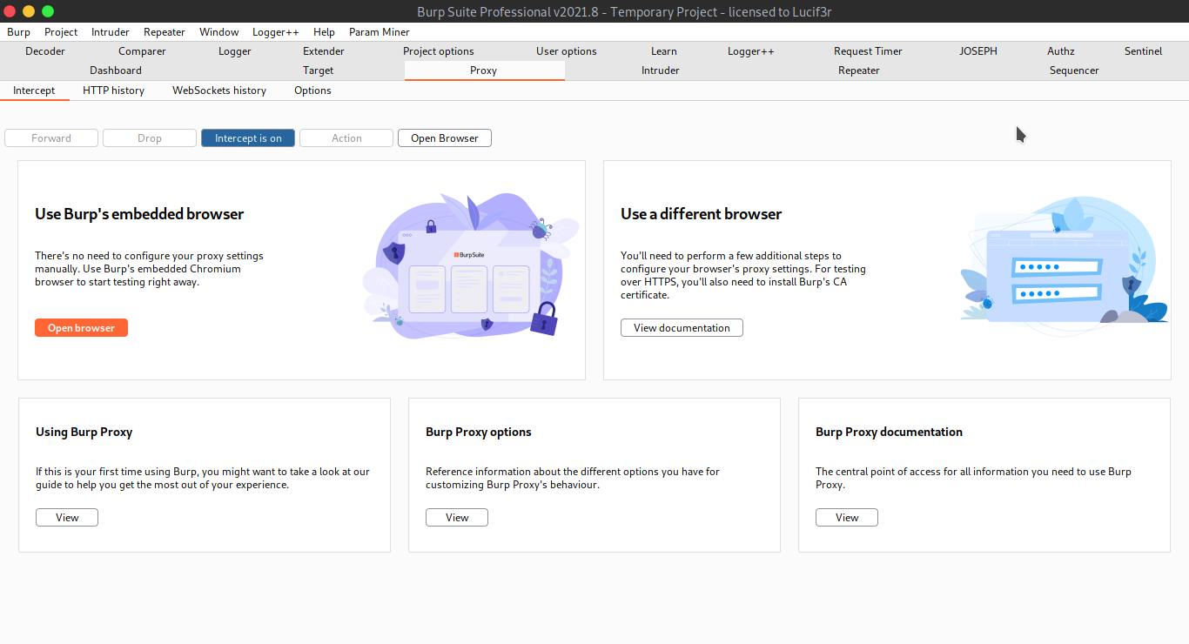
2.
BurpModules:
2.2 Proxy
The Proxy Module is considered to be the most useful part in the BurpSuite.
The proxy module is used to configure the system so as to intercept the traffic between a Browser and the Server.
It operates by being the Man-in-the-Middle.
It lets you intercept, inspect & modify the raw traffic passing in both the directions.
Usually, vulnerabilities such as parameter tampering, sensitive data disclosure, and some other kinds of web vulnerabilities can be estimated directly from this module.
You can see different options in the Proxy Module:

Slide 10
2.
BurpModules:
2.3 Intruder
The Burp intruder is a tool designed to perform the customized attacks against the web applications.
It is literally a powerful tool that can be configured to perform a huge range of tasks from simple brute force attacks guessing of web repositories to active exploitation of complex Time-Based SQL injection Vulnerability.
Different options available under intruder are as follows:
Target
Positions
Payloads
Resource Pool
Options

Slide 11
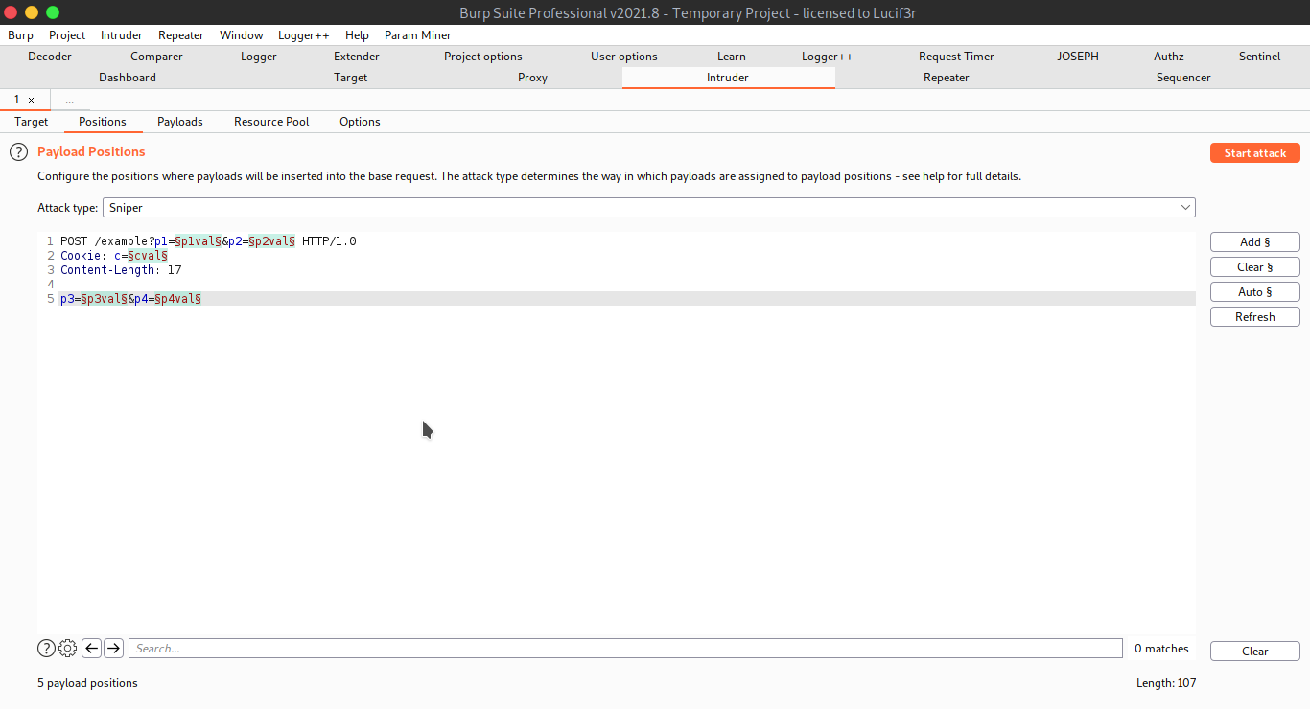
2.
BurpModules:
2.3 Intruder
The Burp intruder is a tool designed to perform the customized attacks against the web applications.
It is literally a powerful tool that can be configured to perform a huge range of tasks from simple brute force attacks guessing of web repositories to active exploitation of complex Time-Based SQL injection Vulnerability.
Different options available under intruder are as follows:
Target
Positions
Payloads
Resource Pool
Options

Slide 12
2.
BurpModules:
2.4 Repeater
Te Burp repeater is again a very interesting tool that is used for manually manipulating and reissuing individual HTTP Requests.
It is used for analyzing the application’s responses.
The repeater can be used for all kinds of purposes such as modifying the parameter values (to check Parameter Tampering) or issuing the requests in a specific sequence to test for logic flaws and reissuing the requests.
A repeater can actually show you the respective responses for the manipulated requests sent.
In this module we can find two major columns:
Request
Response

Slide 13
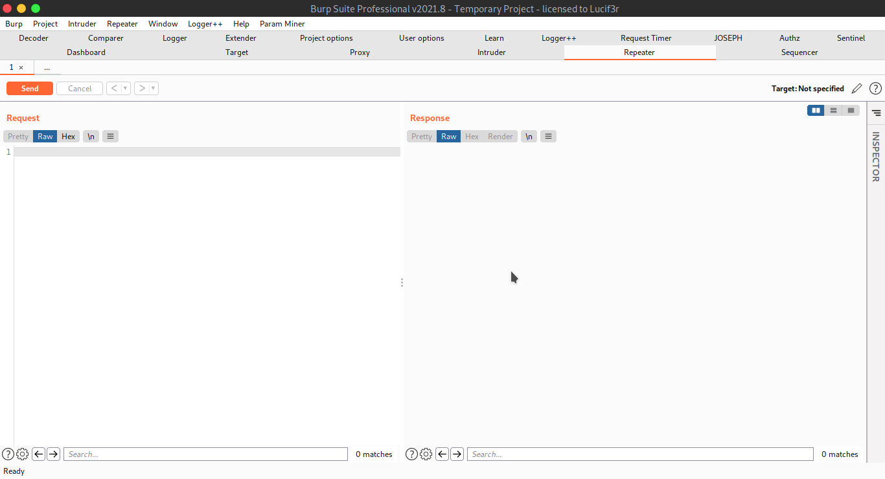
2.
BurpModules:
2.4 Repeater
Te Burp repeater is again a very interesting tool that is used for manually manipulating and reissuing individual HTTP Requests.
It is used for analyzing the application’s responses.
The repeater can be used for all kinds of purposes such as modifying the parameter values (to check Parameter Tampering) or issuing the requests in a specific sequence to test for logic flaws and reissuing the requests.
A repeater can actually show you the respective responses for the manipulated requests sent.
In this module we can find two major columns:
Request
Response

Slide 14
2.
BurpModules:
2.5 Decoder
The decoder is a good tool when it comes to cryptography.
We know, the packets being transmitted are usually encrypted. However, when we intercept the requests, we can get many of the encrypted messages.
Those encrypted messages can be sometimes decrypted using the decoder tool available in the burp suite.
It facilitates the decryption of text messages as well as hex.
We may sometimes require to send the manipulated messages in the form of encrypted messages. Thus, we can encrypt our messages using same tool.
This is how the module looks like:

Slide 15
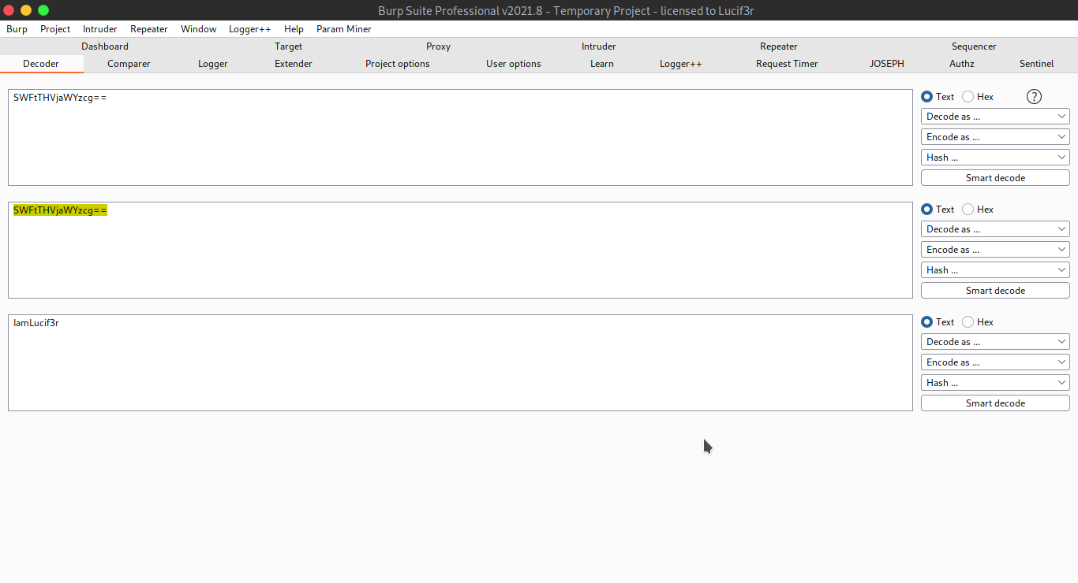
2.
BurpModules:
2.5 Decoder
The decoder is a good tool when it comes to cryptography.
We know, the packets being transmitted are usually encrypted. However, when we intercept the requests, we can get many of the encrypted messages.
Those encrypted messages can be sometimes decrypted using the decoder tool available in the burp suite.
It facilitates the decryption of text messages as well as hex.
We may sometimes require to send the manipulated messages in the form of encrypted messages. Thus, we can encrypt our messages using same tool.
This is how the module looks like:

Slide 16
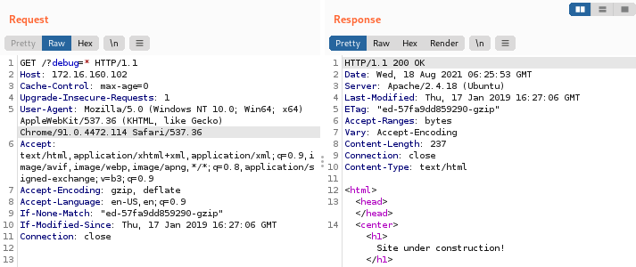
2.
BurpSuite Module:
2.6 Repeater
(Practical Demonstration)
Captured packet from path /?debug=* using Proxy
Response is same as what you see on the webpage
The ‘Repeater’ module helps you to craft your own HTTP/HTTPS packet request and send it to the vulnerable target,to get any unexpected error or response
It is particularly useful when testing Web Apps,to see if they are vulnerable to CSRF,SQLi or XSS attacks
Prerequisites:-
Capturing a GET/POST request using Burp Suite Proxy
Send it to the Repeater,to modify your request

Slide 17
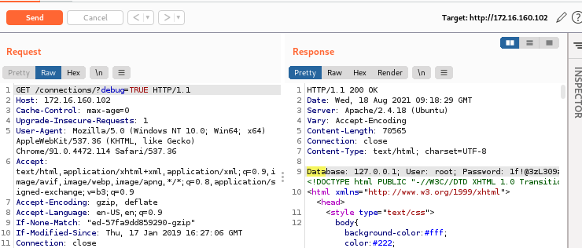
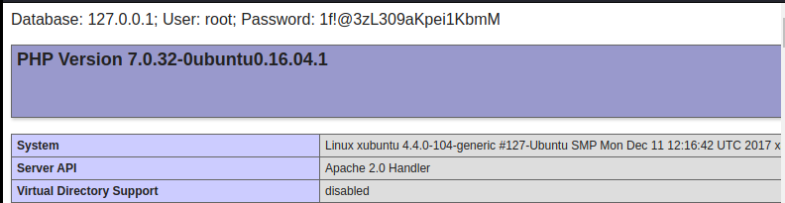
Modified the path (in GET) to invoke logic statement
Send.
Upon trigger,it reveals sensitive info

Slide 18
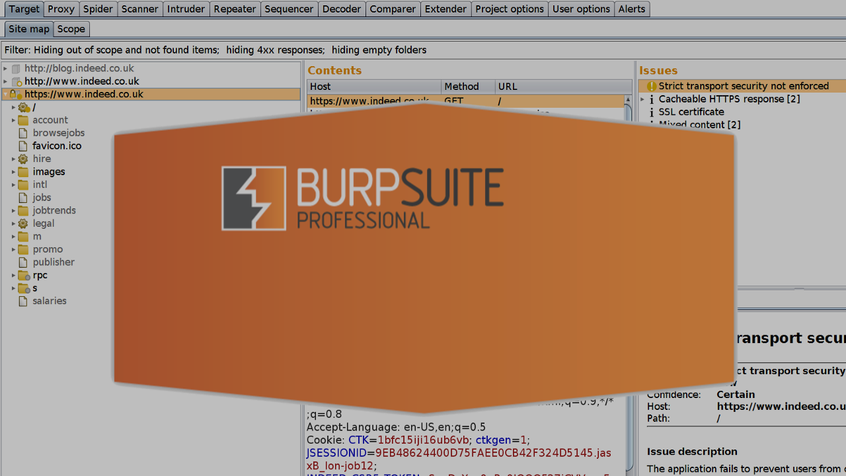
APPLICATIONS

Slide 19
3.
Applications
As already mentioned, Burp Suite is a widely used application for Web Pentesting.
Several Web Application Vulnerability can be identified using the different techniques via burp suite. Some of these are:
XSS
OAuth
SQL Injection
HTTP Host-Header attacks
OTP Bypass
CSRF attacks
Parameter Tampering, etc.

Slide 20
THANK YOU…

